Slide 1

Chapter 11 – part II

Slide 2
OUTLINE
  Stress, strain, and elasticity.
  Problems.

Slide 3
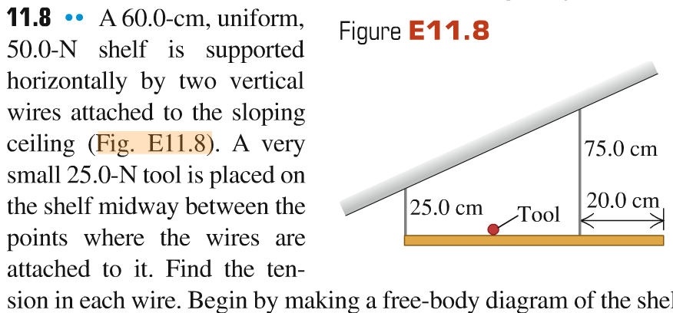
Problem #1

Slide 4

Strain, stress, and elastic moduli
Stretching, squeezing, and twisting a real body causes it to deform, as shown in the figure below. We shall study the relationship between forces and the deformations they cause.
Stress is the force per unit area and strain is the fractional deformation due to the stress. Elastic modulus is stress divided by strain.
The proportionality of stress and strain is called Hooke’s law.

Slide 5
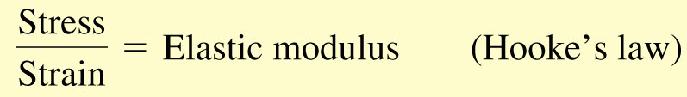
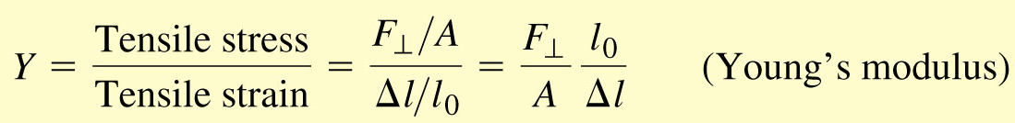
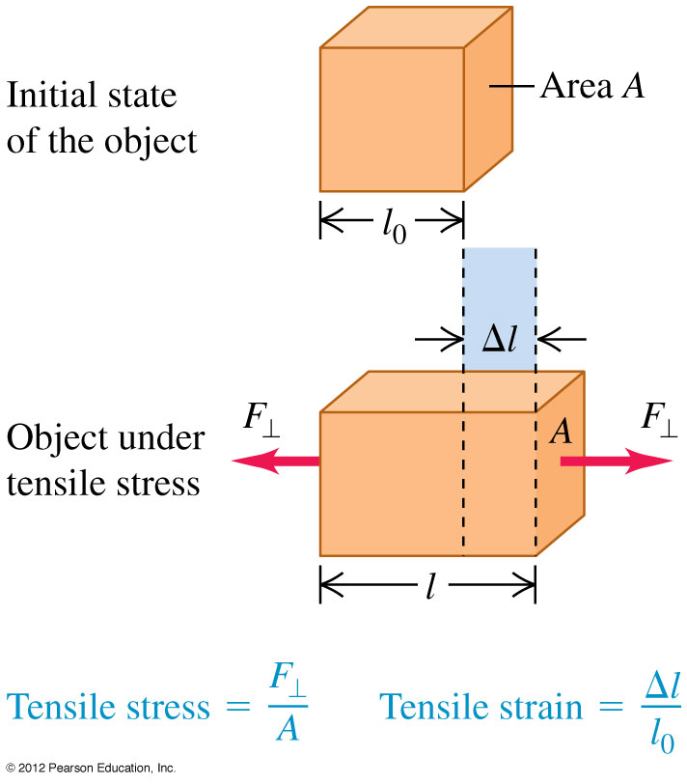
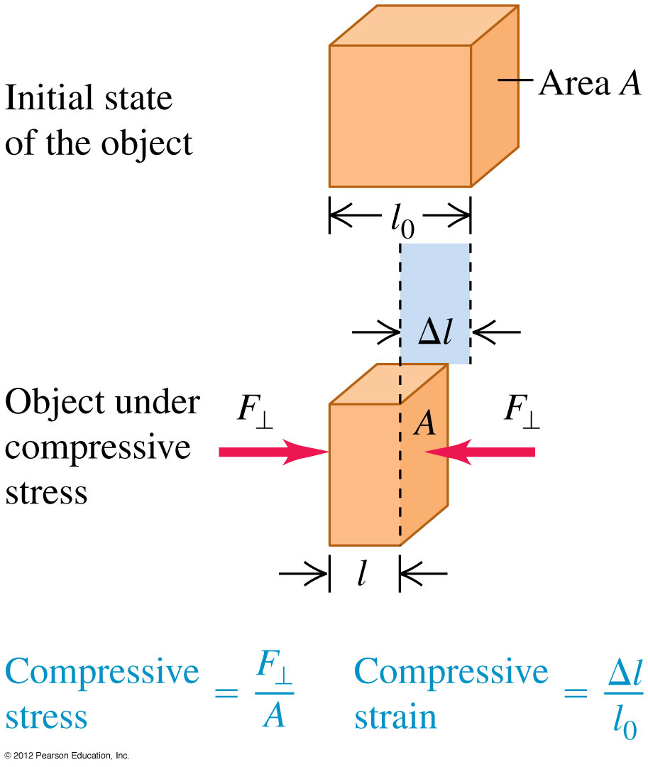
Tensile and compressive stress and strain

Slide 6
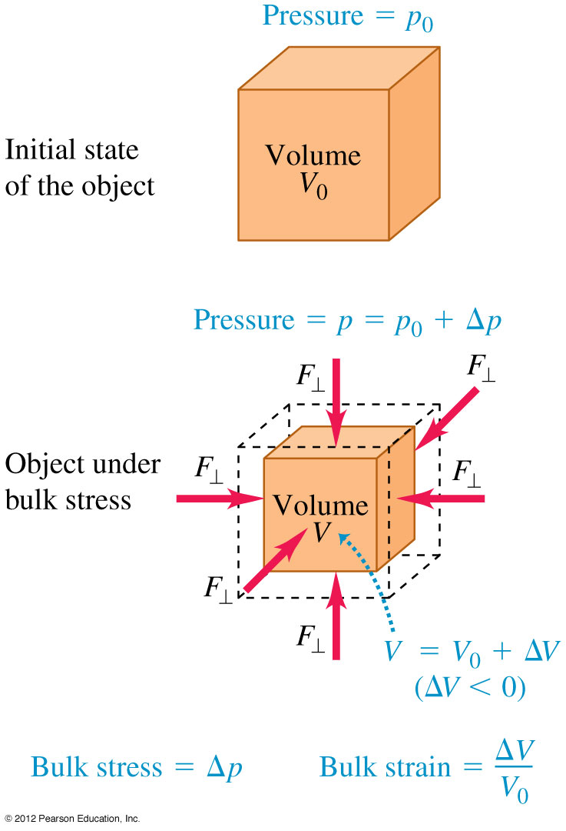
Bulk stress and strain
Pressure in a fluid is force per unit area: p = F/A.
Bulk stress is pressure change Δp and bulk strain is fractional volume change ΔV/V₀. (See Figure 11.16.)
Bulk modulus is bulk stress divided by bulk strain and is given by B = –Δp/(ΔV/V₀)

Slide 7
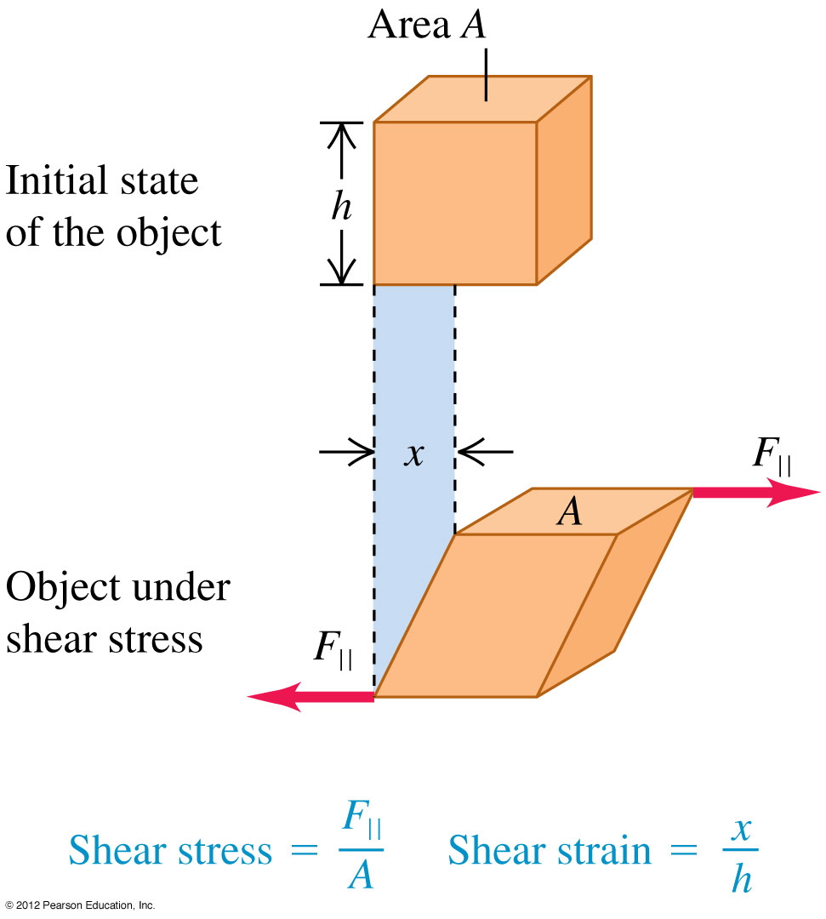
Sheer stress and strain
Sheer stress is F||/A and sheer strain is x/h, as shown in Figure.
Sheer modulus is sheer stress divided by sheer strain, and is given by S = (F||/A)(h/x).

Slide 8
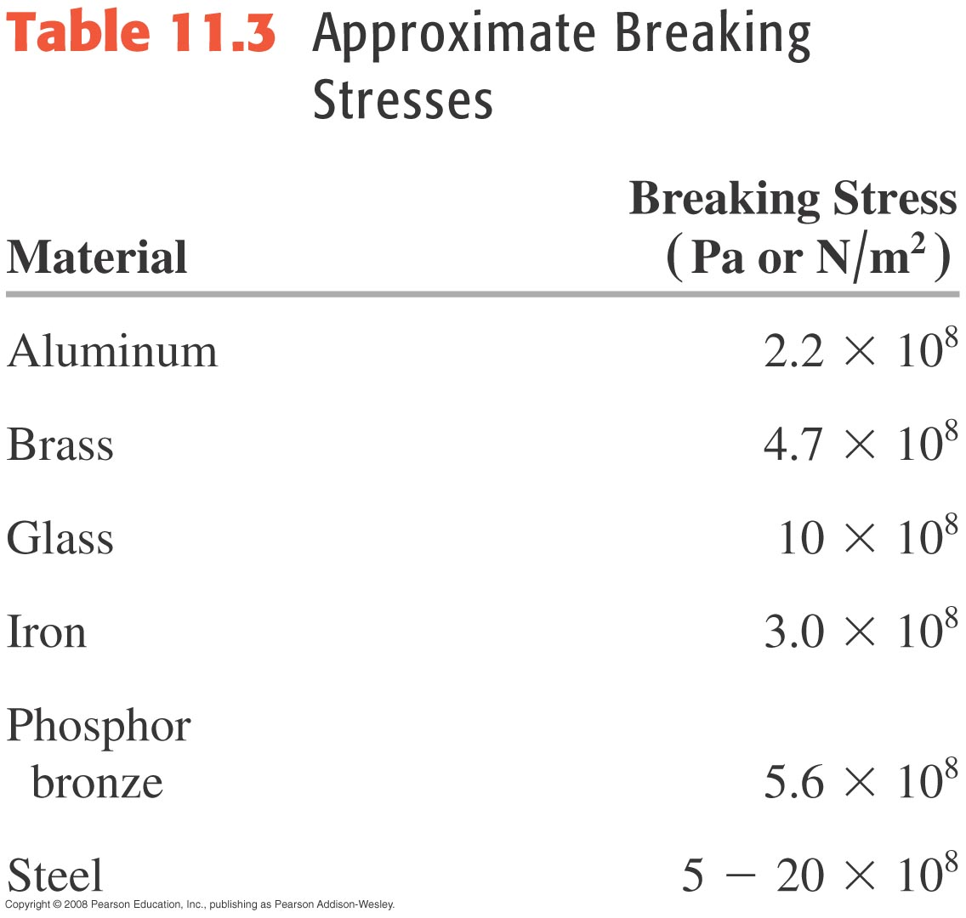
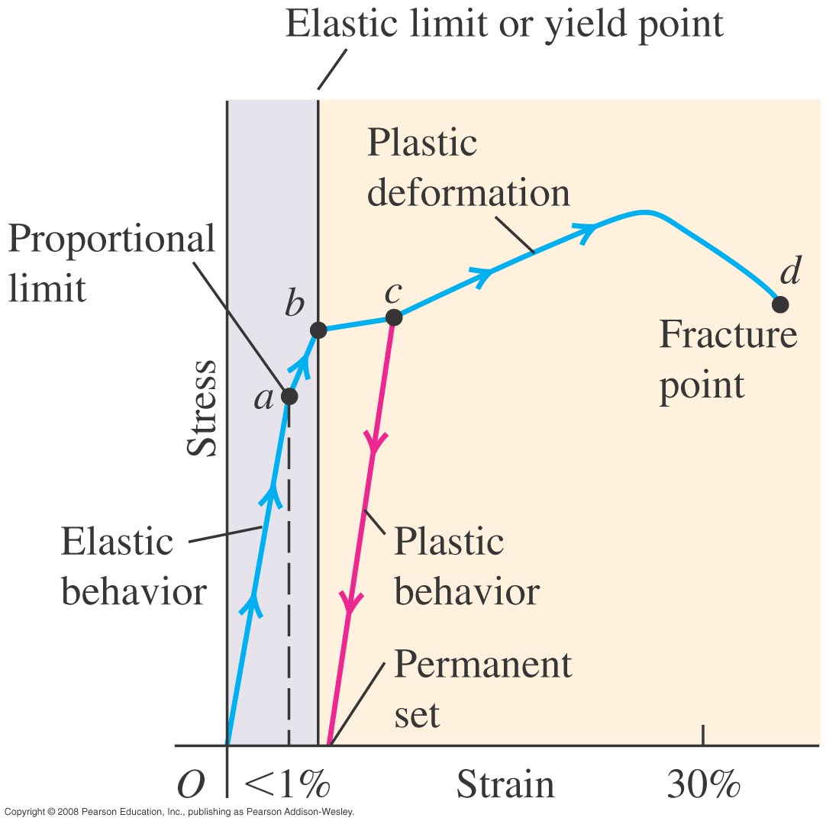
Elasticity and plasticity

Slide 9
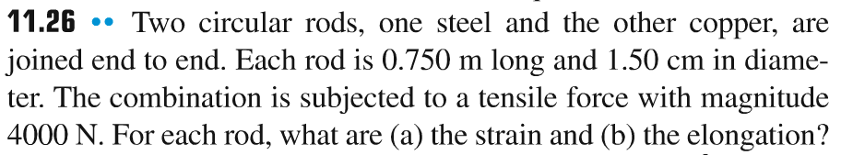
Problem #2

Slide 10
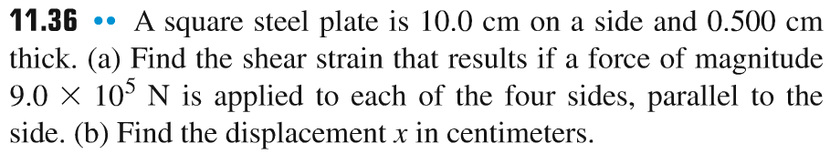
Problem #3

Slide 11
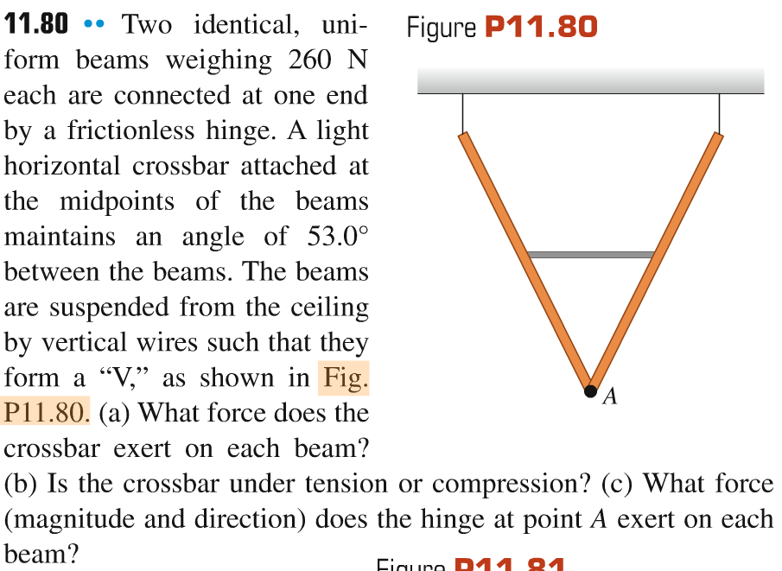
Problem #4

Slide 12
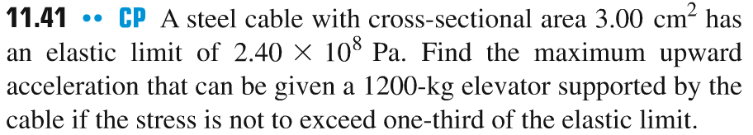
Problem #5

